Slide 1



CAPSTONE PROJECT
SQL MURDER MYSTERY
Presented By: Dristi Handique

Slide 2
OBJECTIVE
A mysterious death has shaken TechNova Inc., leaving behind
scattered logs, conflicting alibis, and unanswered questions. In
this investigation, my role is to step in as the lead data analyst
and use SQL to trace every clue, analyse every dataset, and
uncover who committed the crime, when and where it happened, and how it all unfolded.

Slide 3
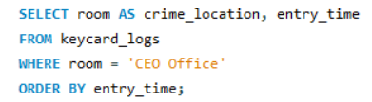

Investigation step 1
Identify where and when the crime happened

Slide 4
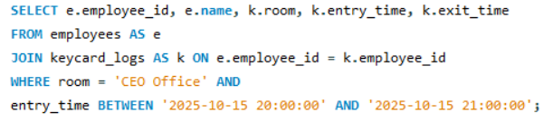

Investigation step 2
Analyze Who Accessed Critical Areas at the Time

Slide 5
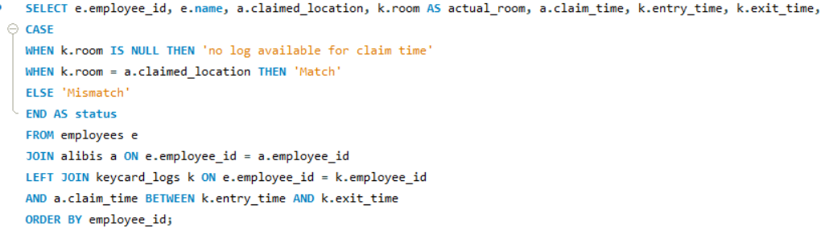
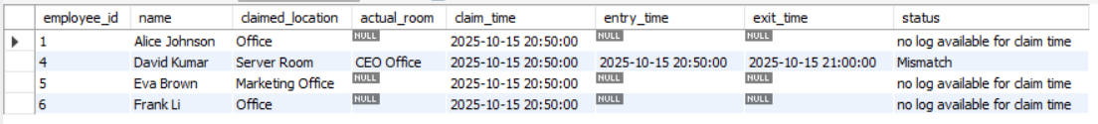
Investigation step 3
Cross-Check Alibis with Actual Logs

Slide 6
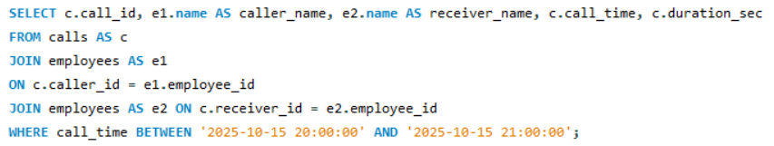

Investigation step 4
Investigate Suspicious Calls Made Around the Time

Slide 7
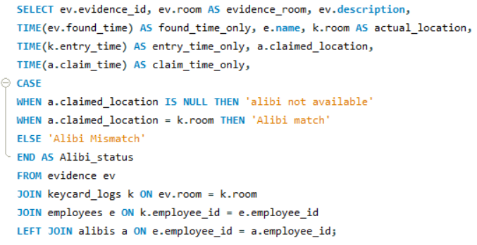
Investigation step 5
Match Evidence with Movements and Claims

Slide 8
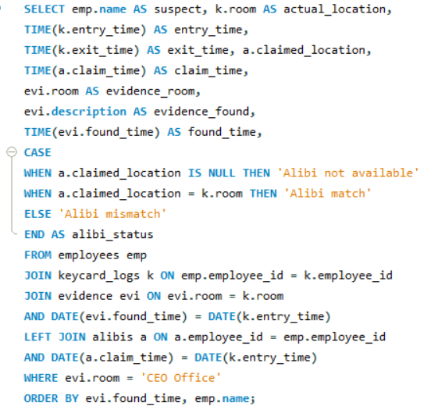
Investigation step 6
Combine All Findings to Identify the Killer

Slide 9
Findings
The murder took place in the CEO’s office around 9 pm.
David Kumar accessed the CEO’s office during the critical time.
He made a false claim about his actual location.
He made two suspicious calls around the same time.
His presence in both the CEO’s office and the server room conflicts with his claimed location, resulting in multiple alibi mismatches.
David Kumar is the prime suspect as evidence from the CEO’s office match the time he was present there, while he falsely claimed to be in the server room.

Slide 10
MURDERER
IS
DAVID KUMAR

Slide 11
THANK YOU

